Slide 1
Bots Bots Bots
Rose Gao, Andrea Koch, Ian Lyons

Slide 2
Agenda
Why are bots important? What are bots? Are they bad?
Proposal
Data
Process
End goals

Slide 3


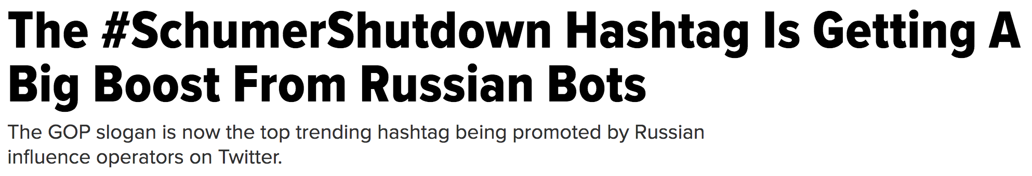
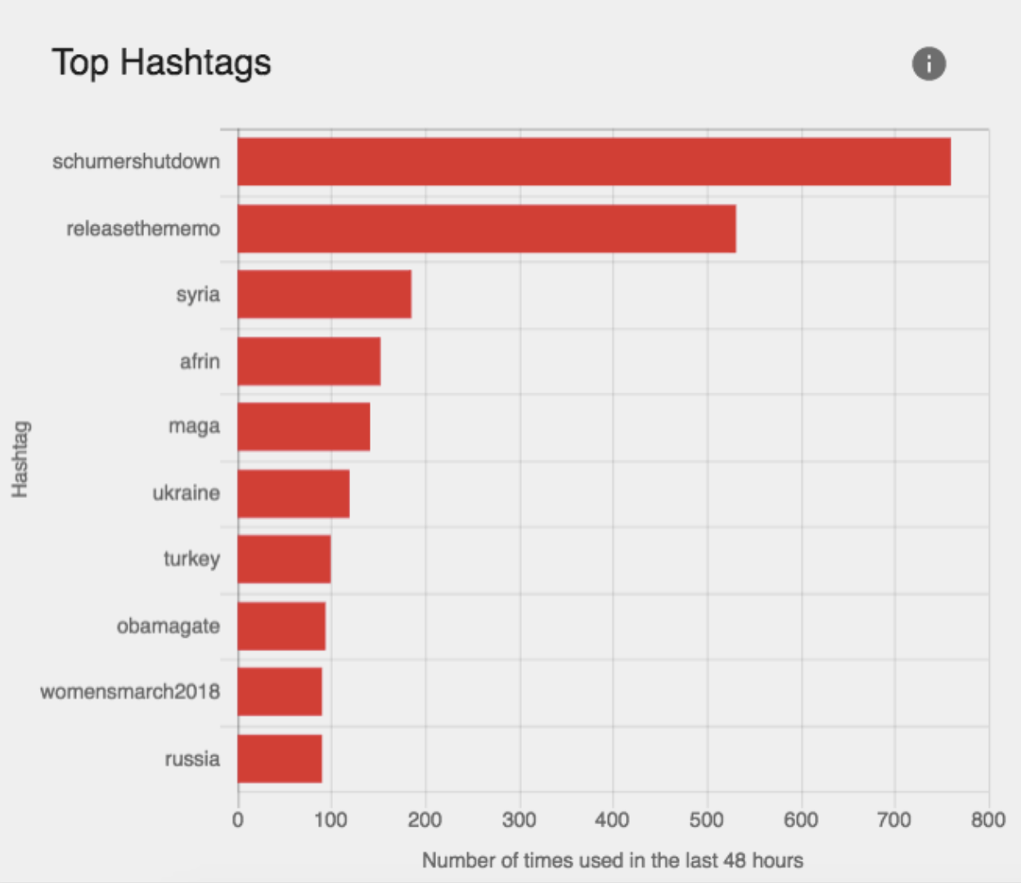
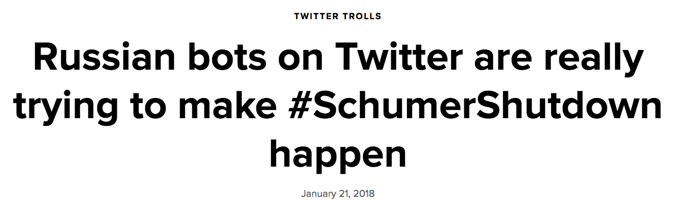
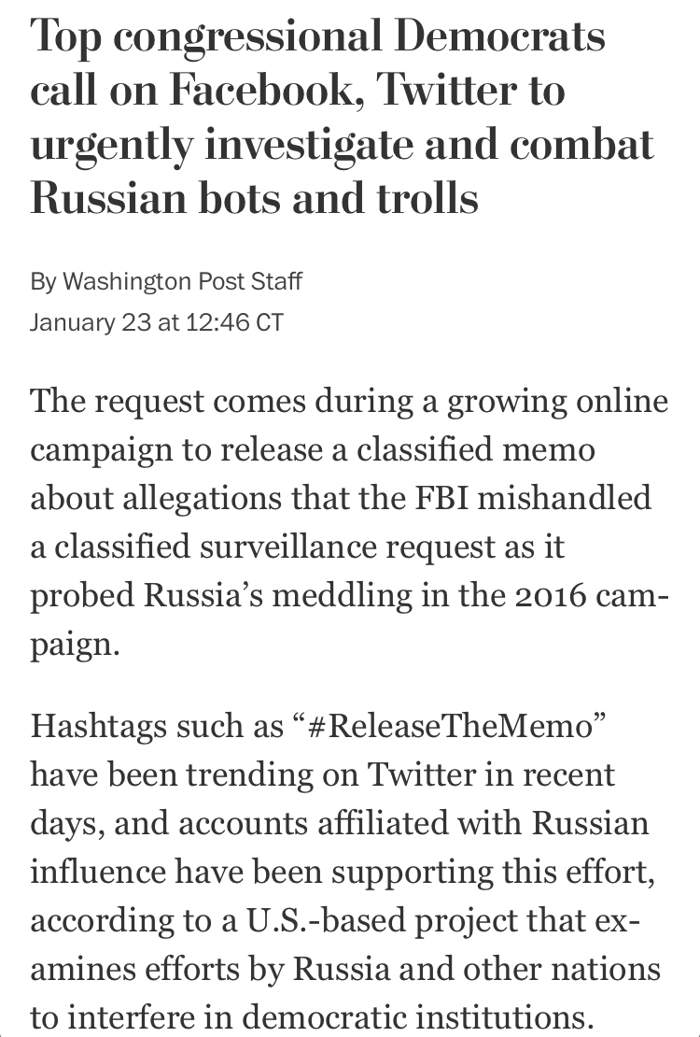
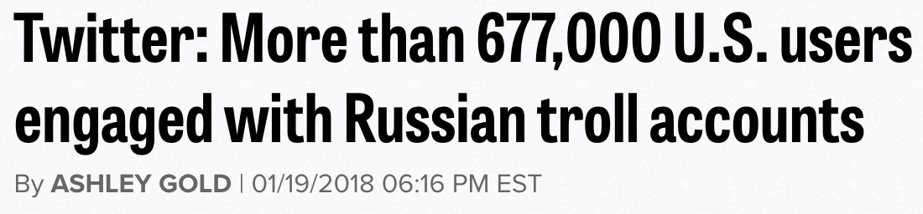
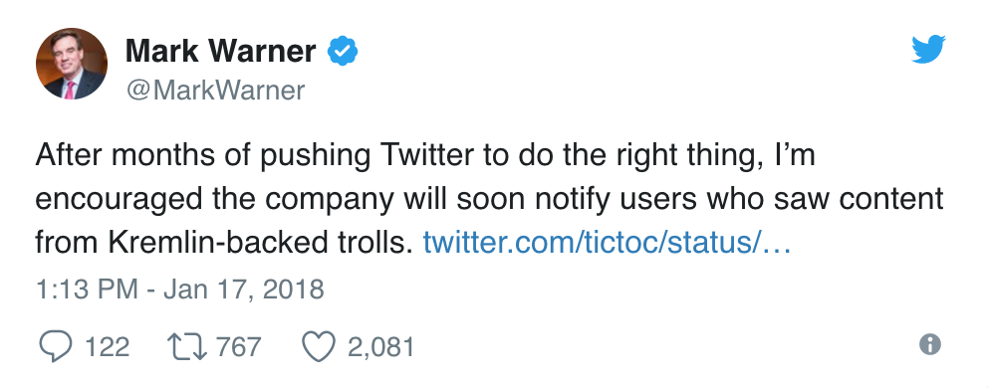
The Bots Are Here to Stay
Notes:
With recent intervention in US and international politics by so-called “bots” on social media, we want to analyze the behavior of these entities.
Perhaps the most well known platform for these bots is Twitter.
See: bot activity re: government shutdown in 2018. 2016 election.
Recent interventions i.e. shutdown
#ReleaseTheMemo
2016 election, push pro-Trump stories
Incite tensions

Slide 4

Proposal:
social bot (n.)
a particular type of chatterbot that is employed in social media networks to automatically generate messages (e.g. tweets) or in general advocate certain ideas, support campaigns, and public relations either by acting as a "follower" or even as a fake account that gathers followers itself
observing the correlations (if any) between bot activity and political events
using trending topics in news, social media, and known important political dates as a proxy for political activity
Notes:
What do we think a bot is:
https://medium.com/data-for-democracy/spot-a-bot-identifying-automation-and-disinformation-on-social-media-2966ad93a203

Slide 5
Data
Training Data:
LIAR Dataset (TSV)
Wikipedia: 2016 events in the US
Will need to scrape and format
Test Data:
Dataset: 2016 US Presidential Election Tweet Ids (JSON)
Time: July 13 - Nov 10, 2016
Twitter API (JSON)
Political hashtags
Collection time: February 2018
Google Trends (CSV)
Collection time: February 2018
Found around the internet!
Notes:
LIAR: a new, publicly available dataset for fake news detection. 12.8K manually labeled short statements in various contexts from POLITIFACT.COM, which provides detailed analysis report and links to source documents for each case.
https://www.cs.ucsb.edu/~william/papers.html
Google Trends: this is how we make a timeline of what is happening in the world
Note that google trends returns an index/scale of searches related to other, not an absolute of the number of searches
The numbers on the graph reflect how many searches have been done for a particular term relative to the total number of searches done on Google over time. They don’t represent absolute search volume numbers, because the data is normalized and presented on a scale from 0-100. Each point on the graph is divided by the highest point, or 100. When there isn’t enough data, 0 is show.
Historical data: (Trained data set) - archives of twitter data from 2016-17
Twitter's Terms of Service do not allow the full JSON for datasets of tweets to be distributed to third parties.
However they do allow datasets of tweet IDs to be shared.
Hydrator helps you turn these tweet IDs back into JSON by retrieving the complete tweet for a tweet id
https://dataverse.harvard.edu/dataset.xhtml?persistentId=doi:10.7910/DVN/PDI7IN
https://github.com/DocNow/hydrator
Twitter limits hydration to 900 requests of 100 tweet ids per 15 minute window per set of user credentials. This works out to 8,640,000 tweets per day.
Twitter API: (Test data set) - from the day we start collecting

Slide 6
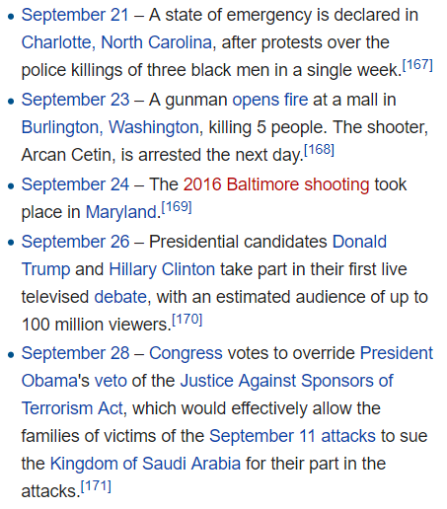
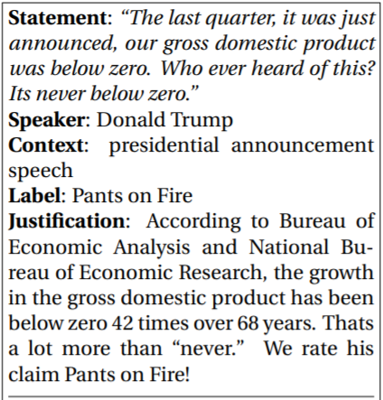
Data Examples
LIAR Dataset Label
Wikipedia 2016 Events

Slide 7
Process
Step 1: Label Fake News
Train set: first half of labeled fake news data, 2016 news events
Create model to detect fake news in a tweet
Test set: second half of labeled fake news data
Use model on tweets to label fake news tweets
Step 2: Detect Fake News Bot Accounts
Filter for accounts that have tweeted fake news
Analyze Twitter account data for signals such as:
Tweet activity time series
Account creation and account renaming, etc.
Network: does the account interact with other bot accounts?
Create a model that returns the likelihood of a fake news bot account
Step 3: Report fake news bot accounts to Twitter, and create a bot that comments on user retweets of fake news, alerting them that they are propagating fake news
Notes:
LIAR:
six fine-grained labels for the truthfulness ratings: pants-fire, false, barely true, half-true, mostly-true, and true.
These statements are sampled from various of contexts/venues, and the top categories include news releases, TV/radio interviews, campaign speeches, TV ads, tweets, debates, Facebook posts, etc. To ensure a broad coverage of the topics, there is also a diverse set of subjects discussed by the speakers. The top-10 most discussed subjects in the dataset are economy, healthcare, taxes, federal-budget, education, jobs, statebudget, candidates-biography, elections, and immigration.
Twitter limits hydration to 900 requests of 100 tweet ids per 15 minute window per set of user credentials. This works out to 8,640,000 tweets per day.
Thus we will run hydrator process on CSIL computer → can we keep it running when we sign out?

Slide 8
End goals:
Report high probability propaganda bot accounts
Alert users of retweeted propaganda
Notes:
Report highly likely social bot accounts
Alert users of retweeted propaganda - we will create a Twitter account bot that comments on retweets and tells the user, e.g. that there is a 90% chance that their retweet is from a tweet by a social bot account

Slide 9
Questions:
Proper scope and feasibility of each step
Best way to store tweets that we are pulling from API
Can we apply LIAR dataset to current Twitter data since it classifies last year’s fake news?
Do we need to create our own mini LIAR dataset for current news?

